Slide 1
Description of variable describing customers activities
Total Duration of the xDR in ms
Minimum value | 7.142988e+06
Maximum value | 1.859336e+09
average | 1.051299e+08
1st quartile | 5.837439e+07
2nd quartile | 8.639999e+07
3rd quartile | 1.329664e+08

Slide 2
Session Duration in ms
Minimum value | 7.142000e+03
Maximum value | 1.859336e+06
average | 1.051294e+05
1st quartile | 5.837400e+04
2nd quartile | 8.639900e+04
3rd quartile | 1.329658e+05

Slide 3
Total Download Data
Minimum value | 7.114041e+06
Maximum value | 9.029696e+08
average | 4.546996e+08
1st quartile | 2.431725e+08
2nd quartile | 4.560177e+08
3rd quartile | 6.657654e+08

Slide 4
Total Upload data
Minimum value | 2.866892e+06
Maximum value | 7.833131e+07
average | 4.112015e+07
1st quartile | 3.321763e+07
2nd quartile | 4.114375e+07
3rd quartile | 4.903338e+07

Slide 5
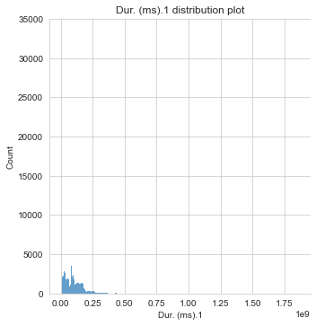
Distribution plots for variable in relation to whole dataset
Total duration of the xDR in ms
The duration distribution lies mostly between 0 and 1/8 of a millisecond with count less than 3000.

Slide 6
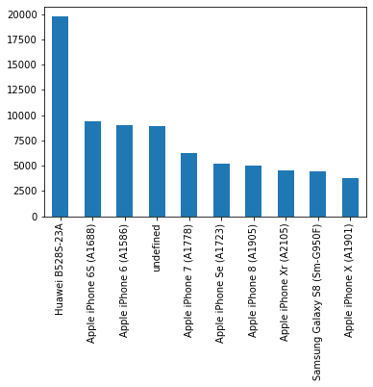
Mostly used Handset Type

Slide 7
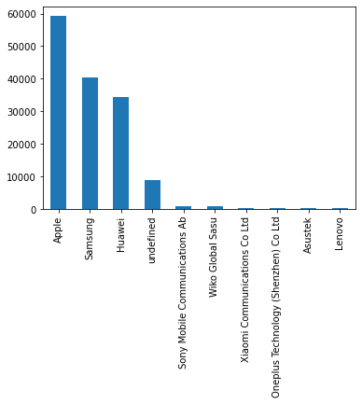
Mostly used Handset Manufacturer

Slide 8
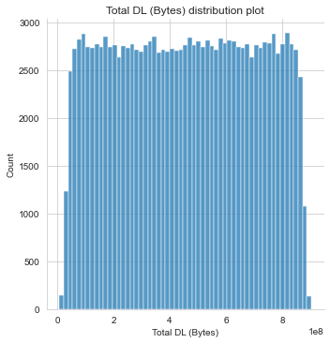
Total Download Volume distribution plot
The distribution rises quickly from 0 to 2500s, stays almost constant until it falls quickly at the end.

Slide 9
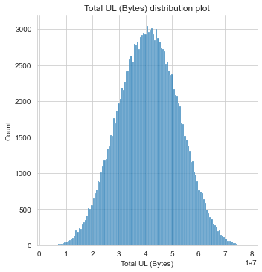
Total Upload Volume distribution plot
The distribution rises slowly until it reaches 3000 count with its upload bytes at the median and then descends slowly.

Slide 10
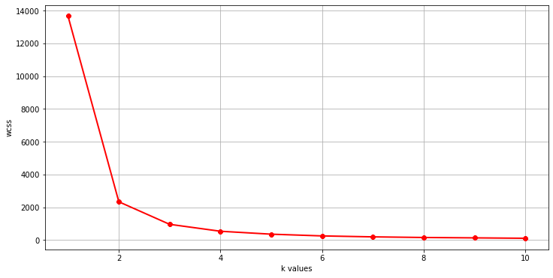
Optimal cluster values using elbow data
Using elbow method, the best classifications counts to be found from our data are 3 as seen from the graph.

Slide 11
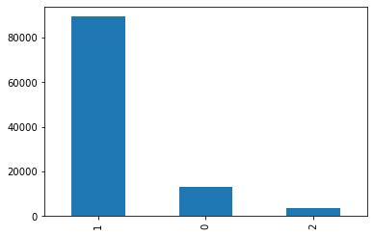
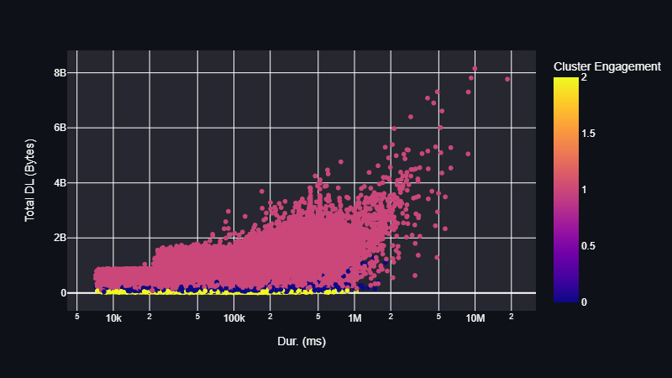
Engagement Clusters
From the graph, we observe the most engaged customers belong to cluster 1

Slide 12
Engagement Clusters
From the graph, we observe the most engaged customers belong to cluster 1
Descriptions about mean for each cluster:
Variables | Mean cluster 1 | Mean cluster 0 | Mean cluster 2
Duration | 2.420023e+06 | 2.929371e+05 | 1.892775e+05
Total DL | 1.413801e+09 | 2.571667e+08 | 5.810468e+07
Total UL | 1.227956e+08 | 6.307089e+07 | 4.466235e+07
Decile | 1.116656e+04 | 1.659390e+03 | 4.729893e+02
Satisfaction score | 2.163723e+09 | 4.536743e+08 | 1.456310e+08

Slide 13
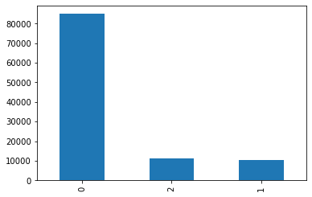
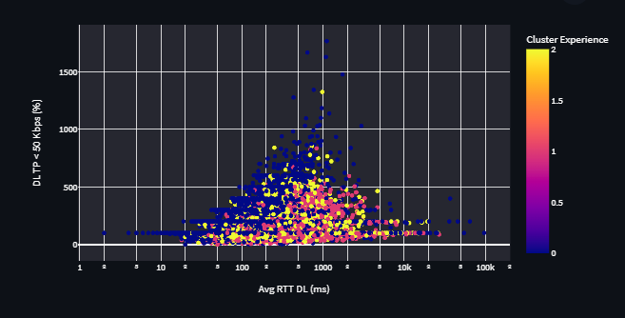
Experience Clusters
From the observations from the experience clusters, cluster 0 has the highest count

Slide 14
Experience Clusters
From the graph, we observe the most engaged customers belong to cluster 0
Descriptions about mean for each cluster:
Variables | Mean cluster 0 | Mean cluster 2 | Mean cluster 1
Duration | 2.421906e+06 | 7.789314e+05 | 6.654174e+05
Total DL | 1.208157e+08 | 1.084307e+08 | 1.054051e+09
Total UL | 1.360509e+09 | 1.305942e+09 | 9.470554e+07
Decile | 1.061507e+04 | 1.382236e+03 | 1.300965e+03
Satisfaction score | 2.088941e+09 | 2.003189e+09 | 1.625822e+09

Slide 15
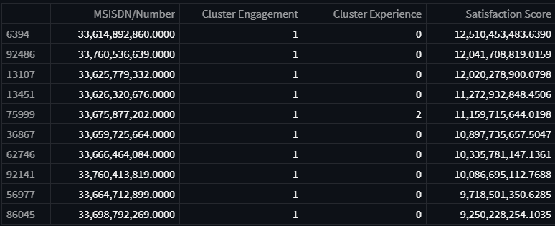
Top 10 most satisfied customers

Slide 16
Creator
Names: Floris Nzabakira
Email: nzafloris@gmail.com
GitHub: https://github.com/Kira-Floris/TellCo

